Slide 1

Hemvati Nandan Bahuguna Garhwal University School of Engineering and Technology Department of Computer Science and Engineering
Session: 2020-24 Project Presentation
On
SHOPPING CART MANAGEMENT SYSTEM
Submitted To: Dr. Prem Nath
Associate Professor
Submitted By: Swayam
CSE, 4th Sem
Roll. 20134501038

Slide 2
CONTENTS
INTRODUCTION
FEATURES
FUNCTIONALITY PROVIDES
OUTPUT
BENIFITS
REFRENCES
FLOW CHART

Slide 3

INTRODUCTION
Shopping Cart Management System is developed using basic of C++ programming language and different variables, strings have been used for development of it.
This project is based on the concept of choosing desired products from the list and generating total bill amount.
This project provides the simplest system for management of shopping cart.

Slide 4
FEATURES
User will able to purchase Mobiles, Laptops, Watches etc displays in the main menu.
User will able to see prices of products.
User will able to choose items.
User will able to add quantity of products.
User will able to get total bill.

Slide 5
FUNCTIONALITY PROVIDED
CustomerName() – Function is used for customer details.
Onlineshopping() – Function is created for displaying menu to user.
If-else - Used for choice and subchoice.
Goto - Used as jump statement.
Jump Statement is used to jump from one menu to another within program.

Slide 6
FLOW CHART
START ONLINE SHOPPING
DISPLAYING LIST OF ITEMS
CHOOSING ITEMS
ENTER QUANTITY OF PRODUCTS
CALCULATE TOTAL BILLING AMOUNT
EXIT

Slide 7
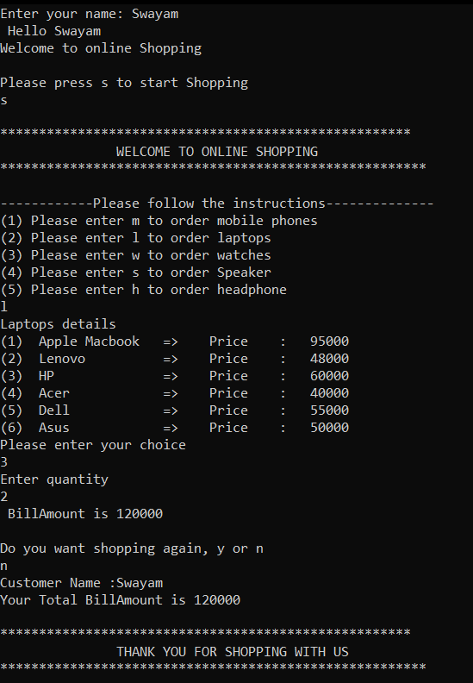
OUTPUT
Let us suppose, someone need to buy 2 HP laptops.

Slide 8
BENEFITS
It helps in eliminating all paper works.
Saves time
Improves customer services
Speed up various processes such as addition of items, calculation of total bills
User friendly
Easy to use

Slide 9
REFERENCES
https://www.geeksforgeeks.org/implementing-interactive-online-shopping-in-c/
https://www.interviewbit.com/blog/cpp-projects/
https://techvidvan.com/tutorials/cpp-pros-and-cons/
https://www.researchgate.net/
https://www.slideshare.net/

Slide 10
THANK YOU..

